Slide 1
Nova Scotia
Pothole Detection
COMP 4613 Final Project
Benjamin Kelln

Slide 2
PROBLEM DEFINITION:
Potholes are bad
Vehicle damage, injury and even death
Nova Scotia has very bad road conditions
Largely due to well-defined ‘wet’ and ‘dry’ seasons
Potholes will pose a real threat to autonomous vehicles
A self-driving car that loses control when hitting a pothole is a very scary thought but entirely possible

Slide 3
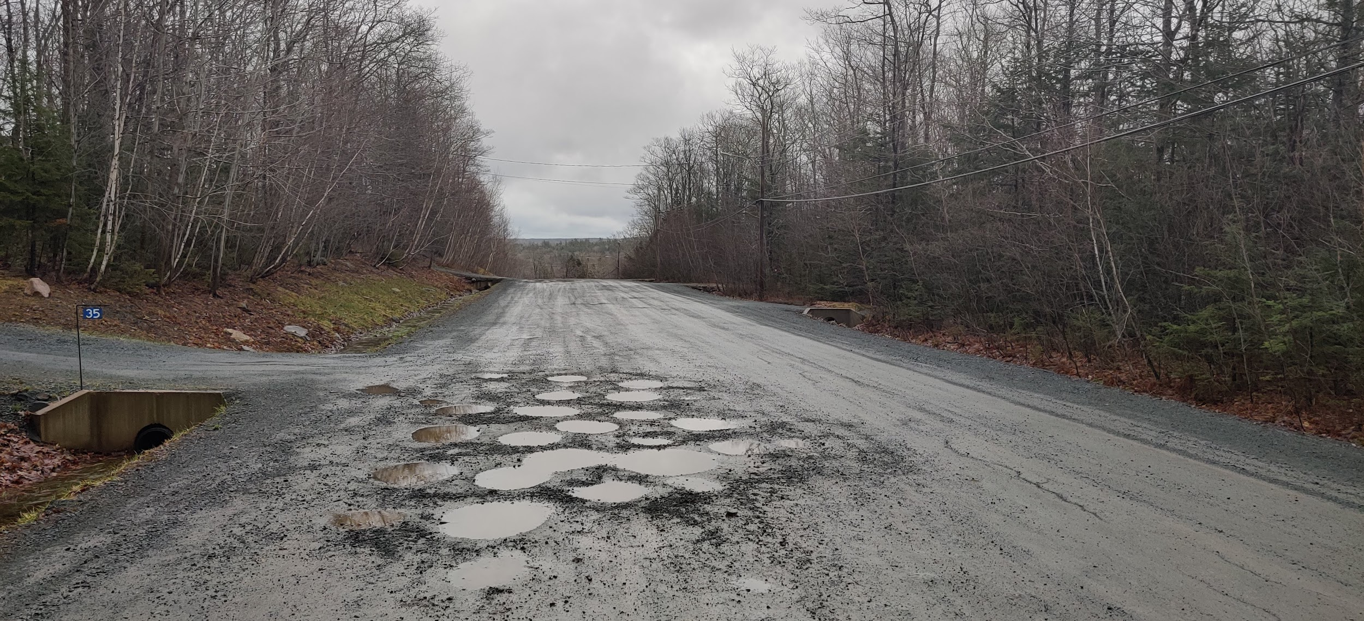
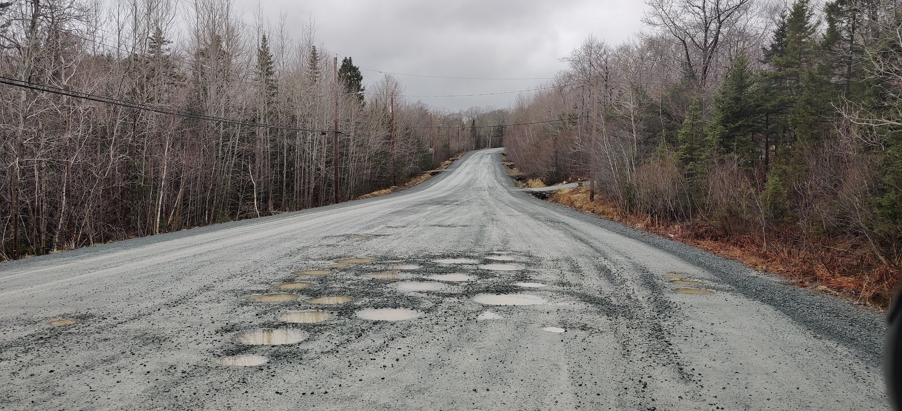
JUST UP THE ROAD FROM ME

Slide 4
DATASET
Found on Kaggle.com from a user named Atulya Kumar who described that it was scrapped from the web
A collection of varying sized images within an archive that contains 2 separate folders
Potholes vs normal

Slide 5
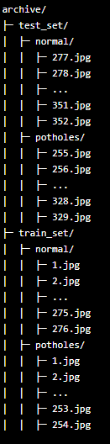
FILE STRUCTURE

Slide 6
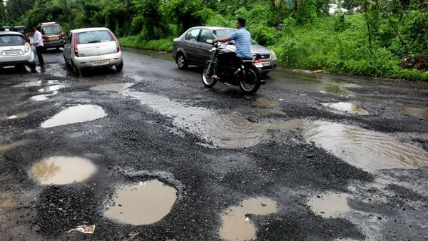
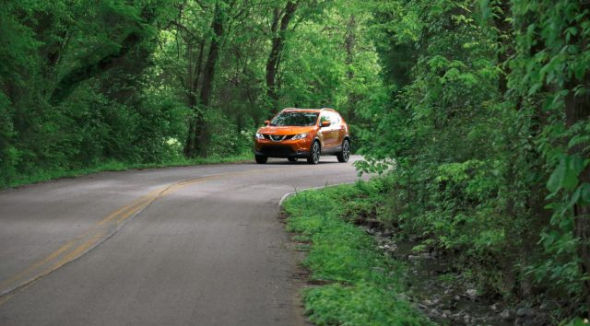
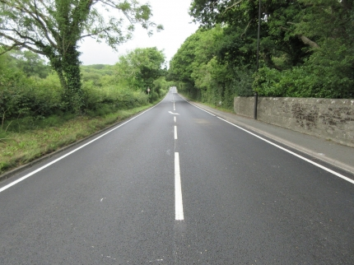
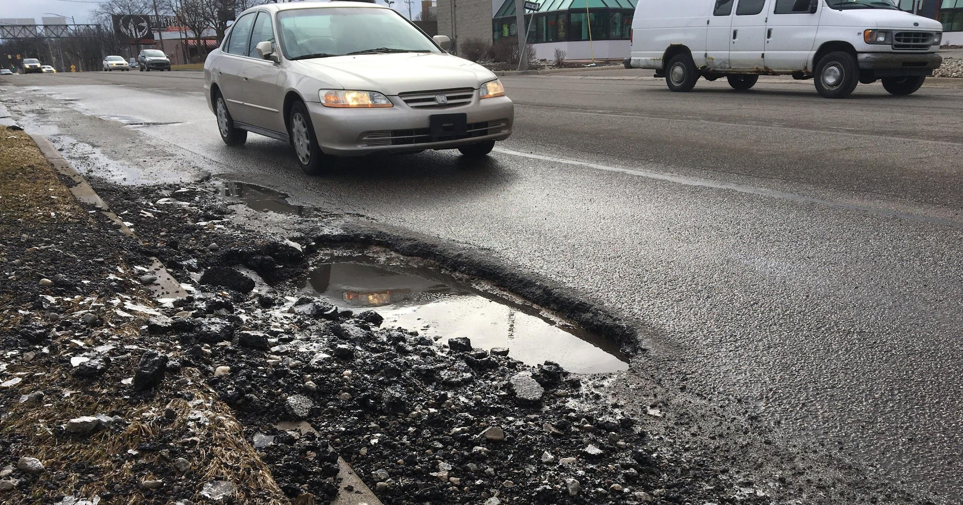
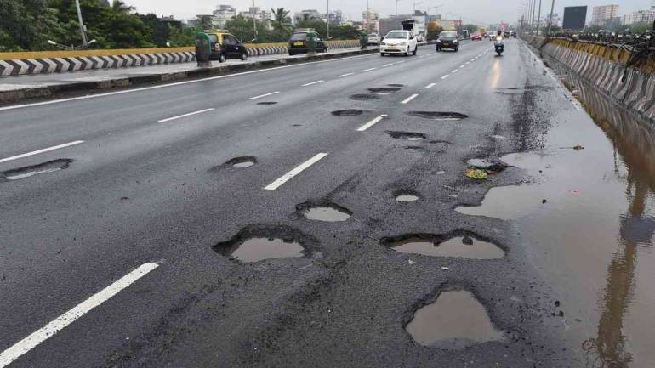
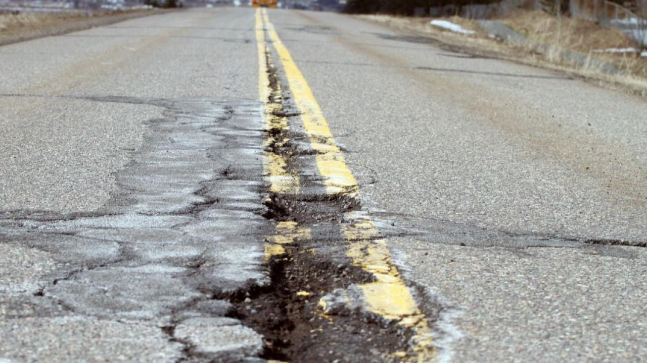
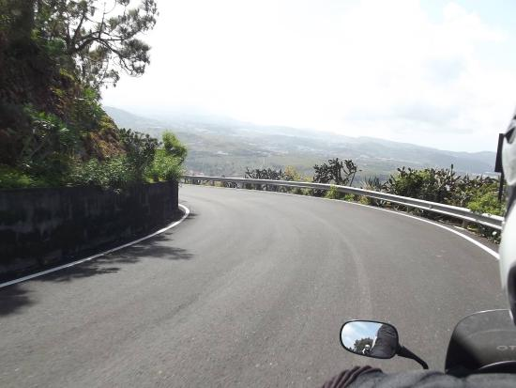
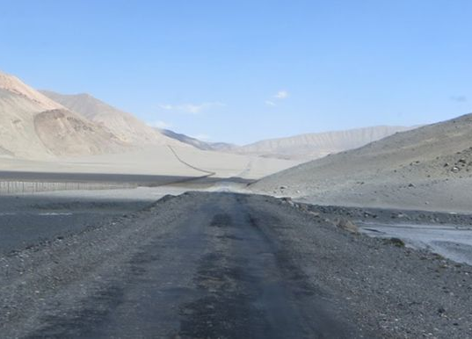
DATASET EXAMPLES
POTHOLES
NORMAL

Slide 7
AUGMENTED IMAGE THEORY
Thought to myself that potholes are pretty prevalent features in a road, look very different than rest of road
Maybe there is a way for us to accentuate this
So our CNN can find a pothole ‘feature’ more accurately
What makes a pothole so easy to spot?
Curvature?
Color?
Contrast?

Slide 8
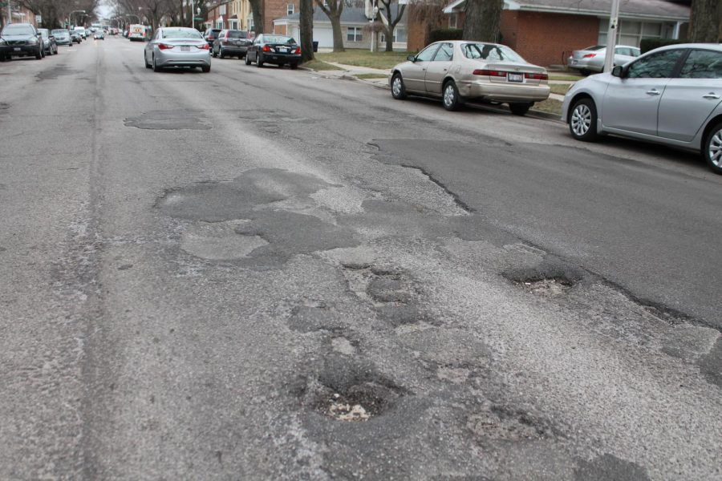
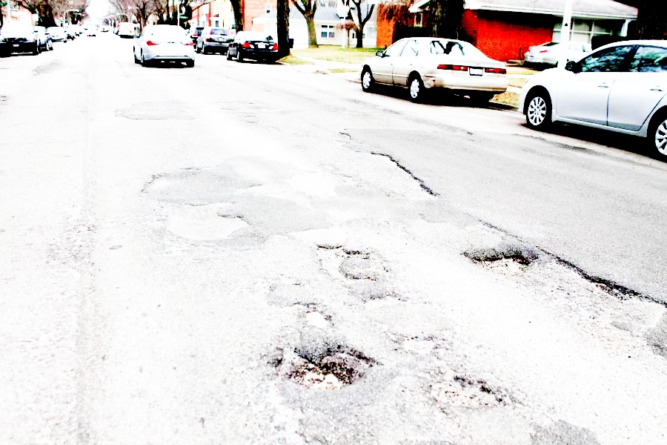
AUGMENTED IMAGE THEORY
CONTRAST
NORMAL
EXPOSURE

Slide 9
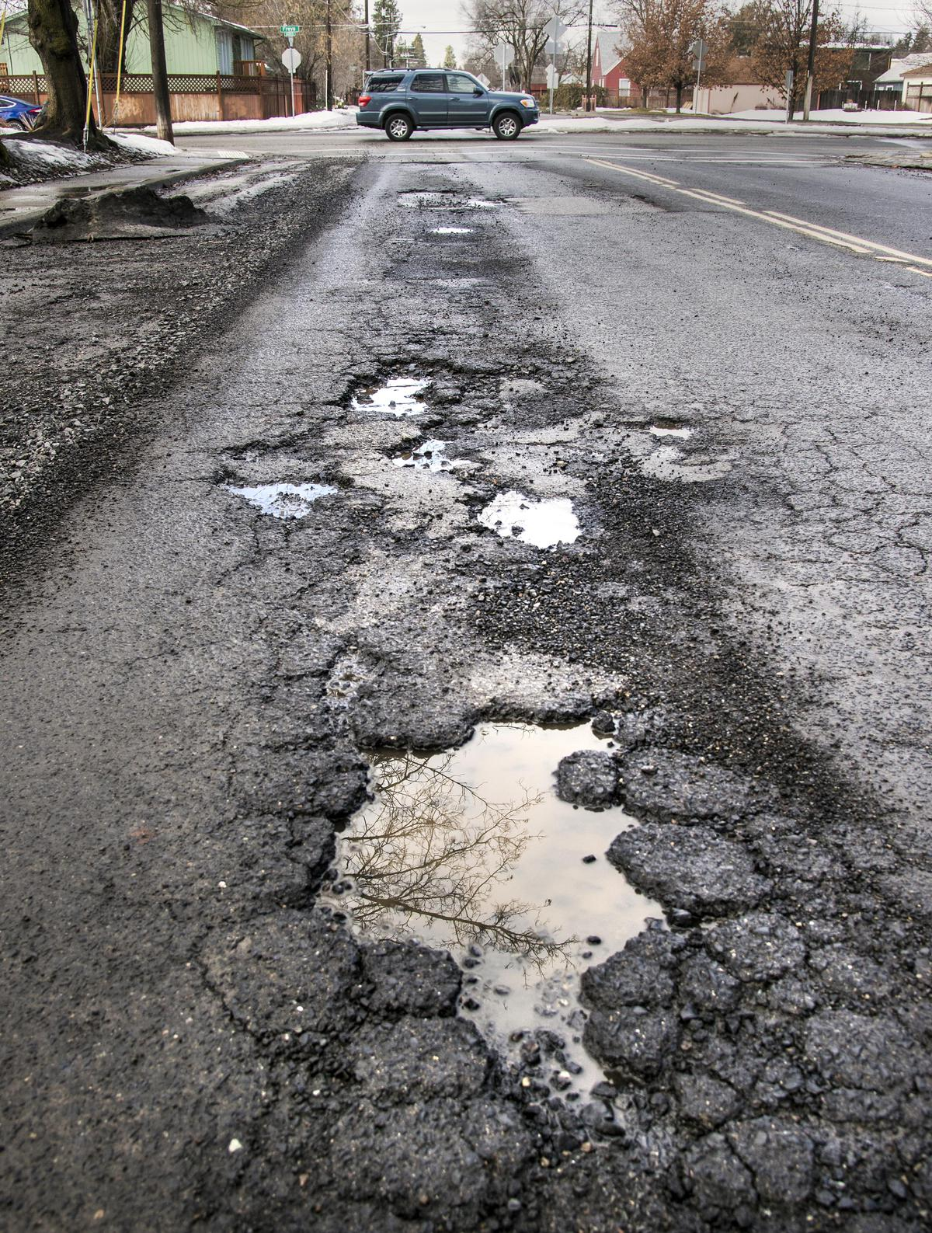
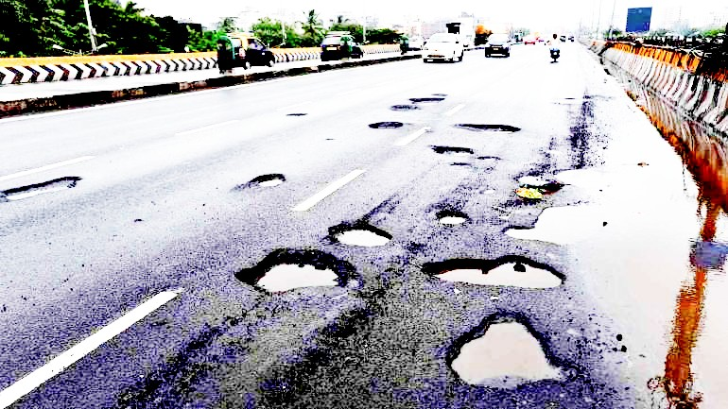
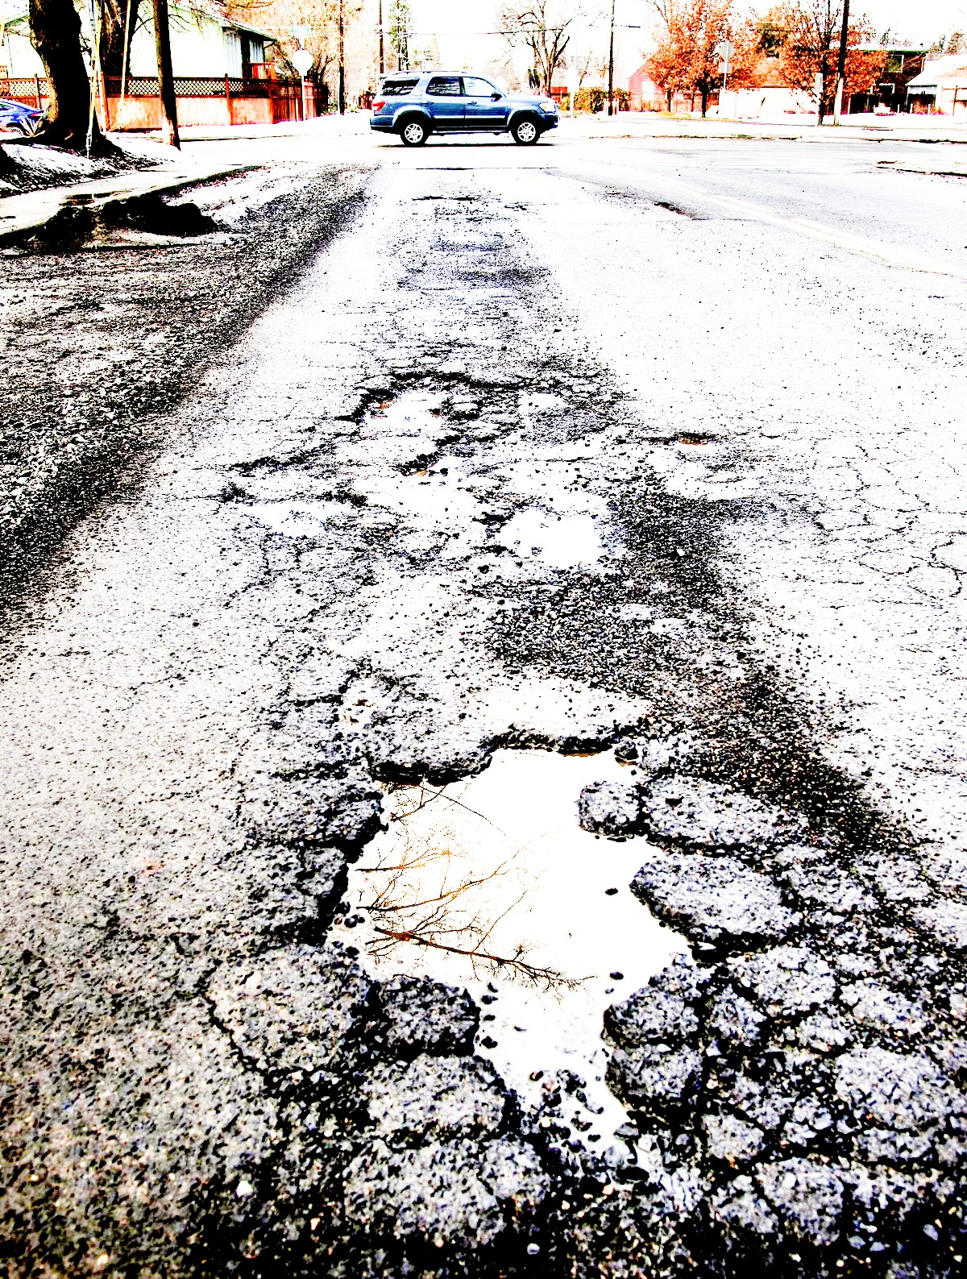
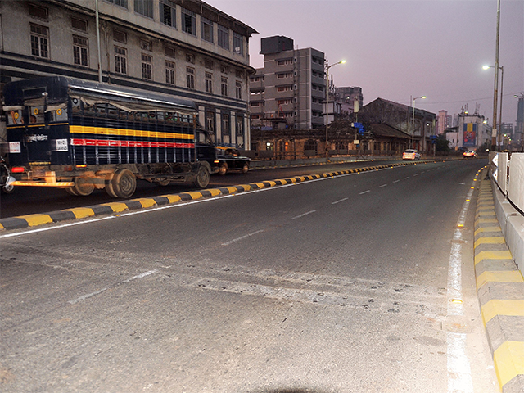
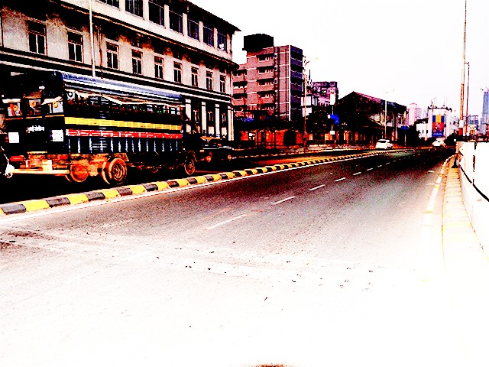
AUGMENTED DATASET EXAMPLES
NORMAL
AUGMENTED

Slide 10
EXPECTED SUCCESS CRITERIA
Normal Images: 75% Accuracy
Augmented Images: 80% Accuracy

Slide 11
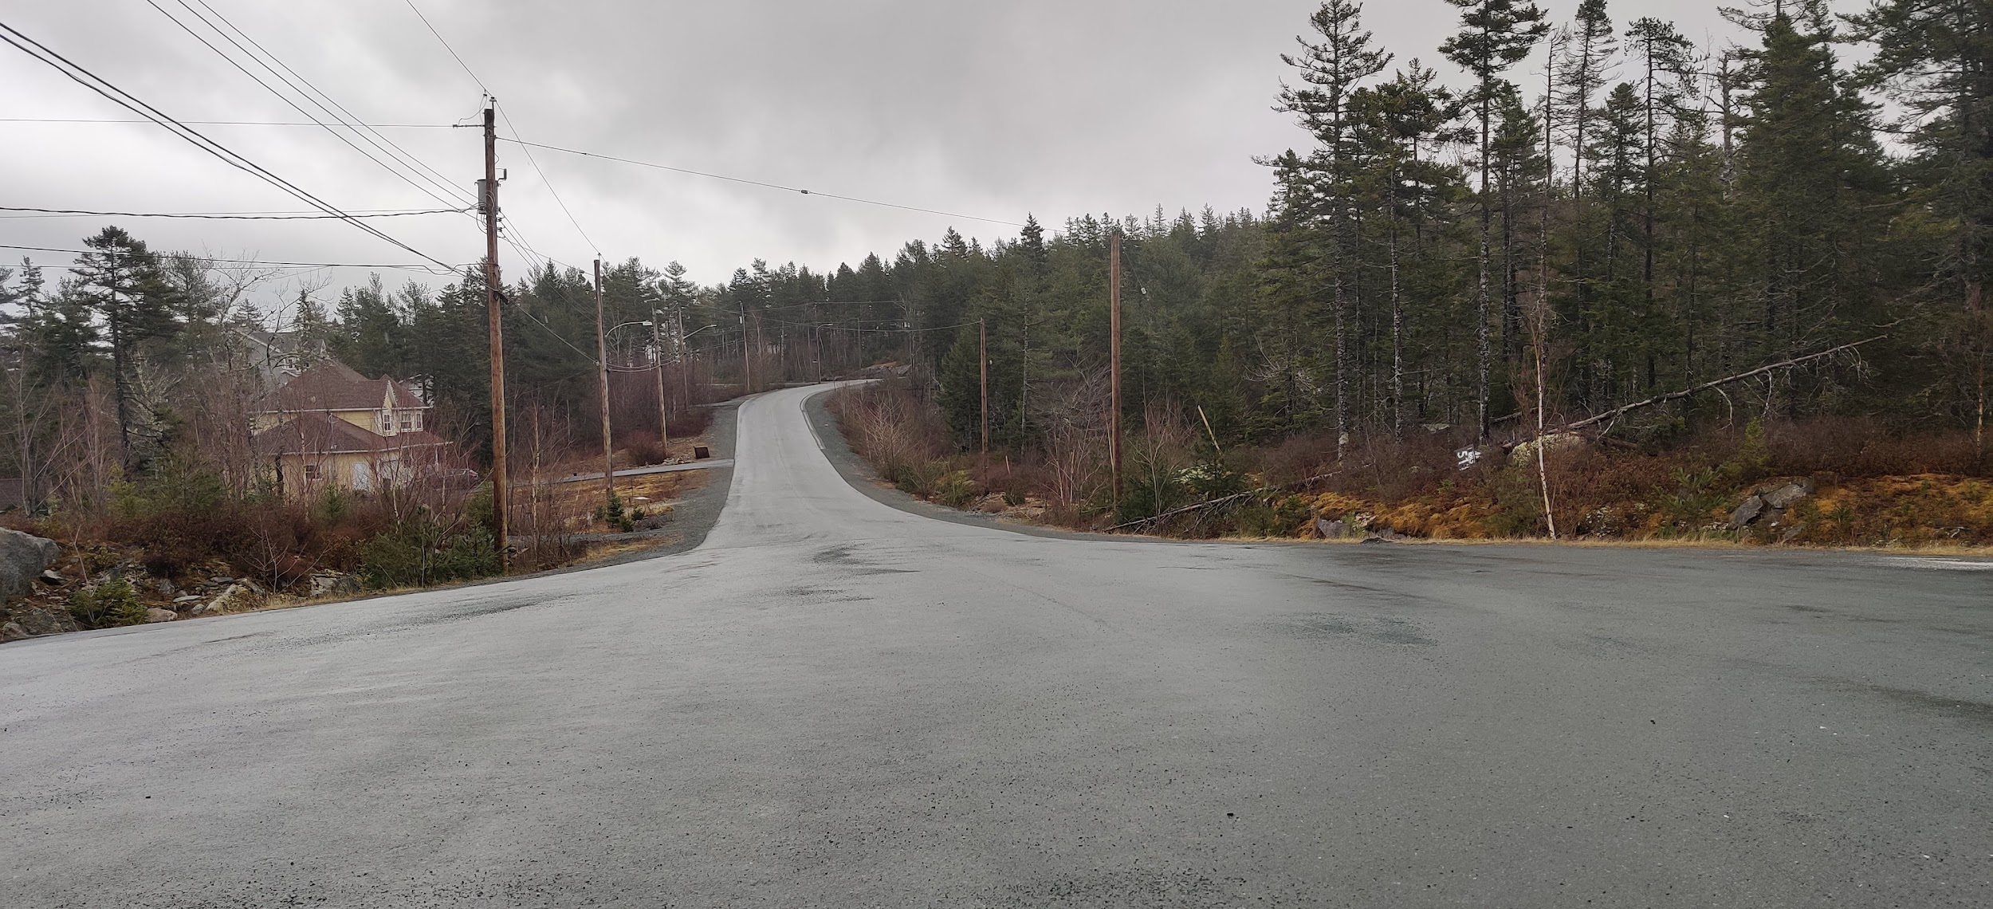
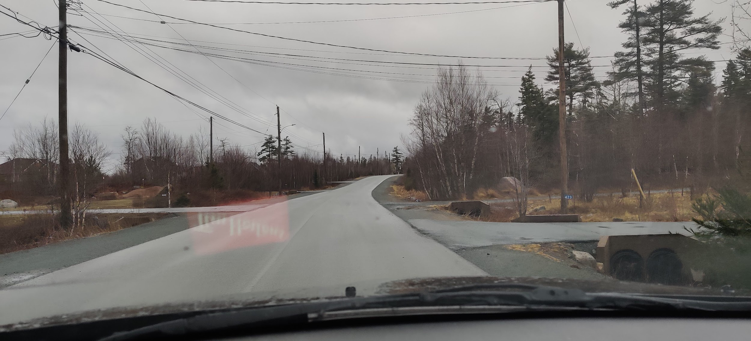
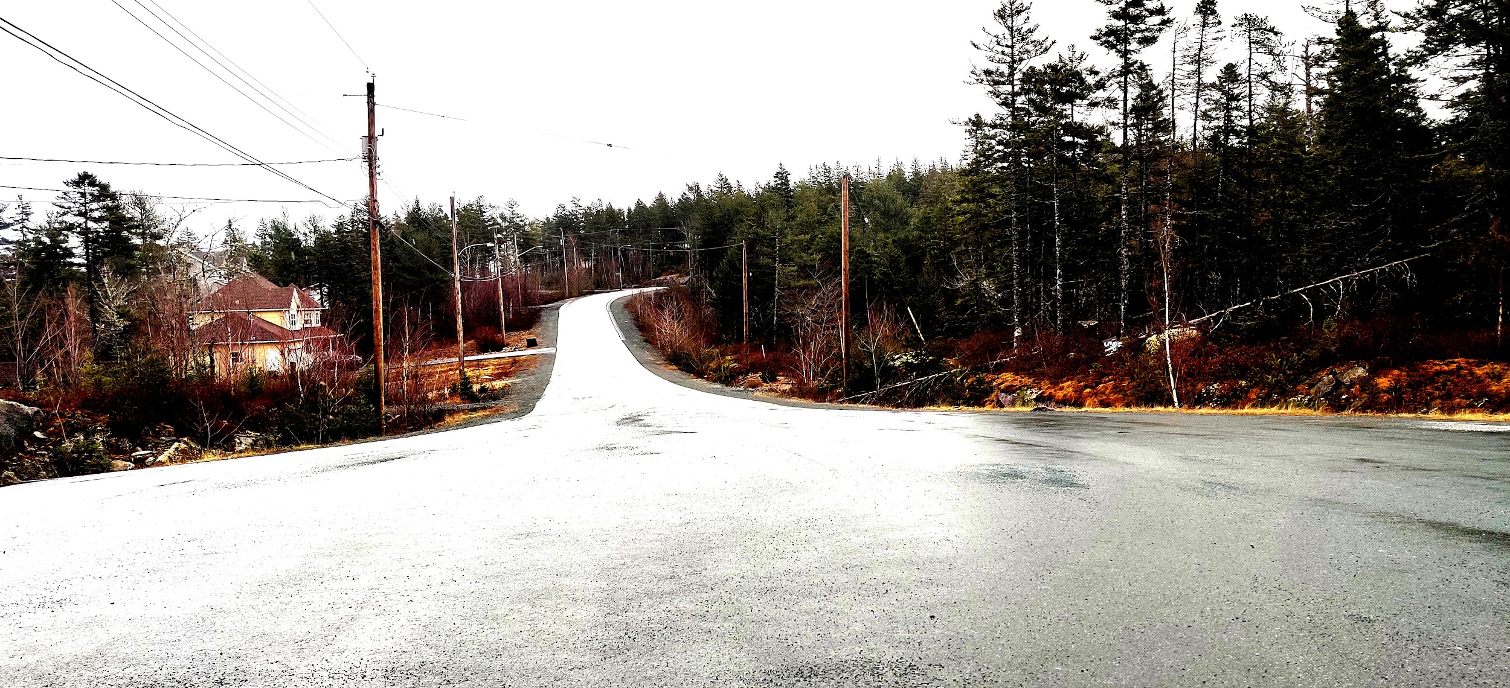
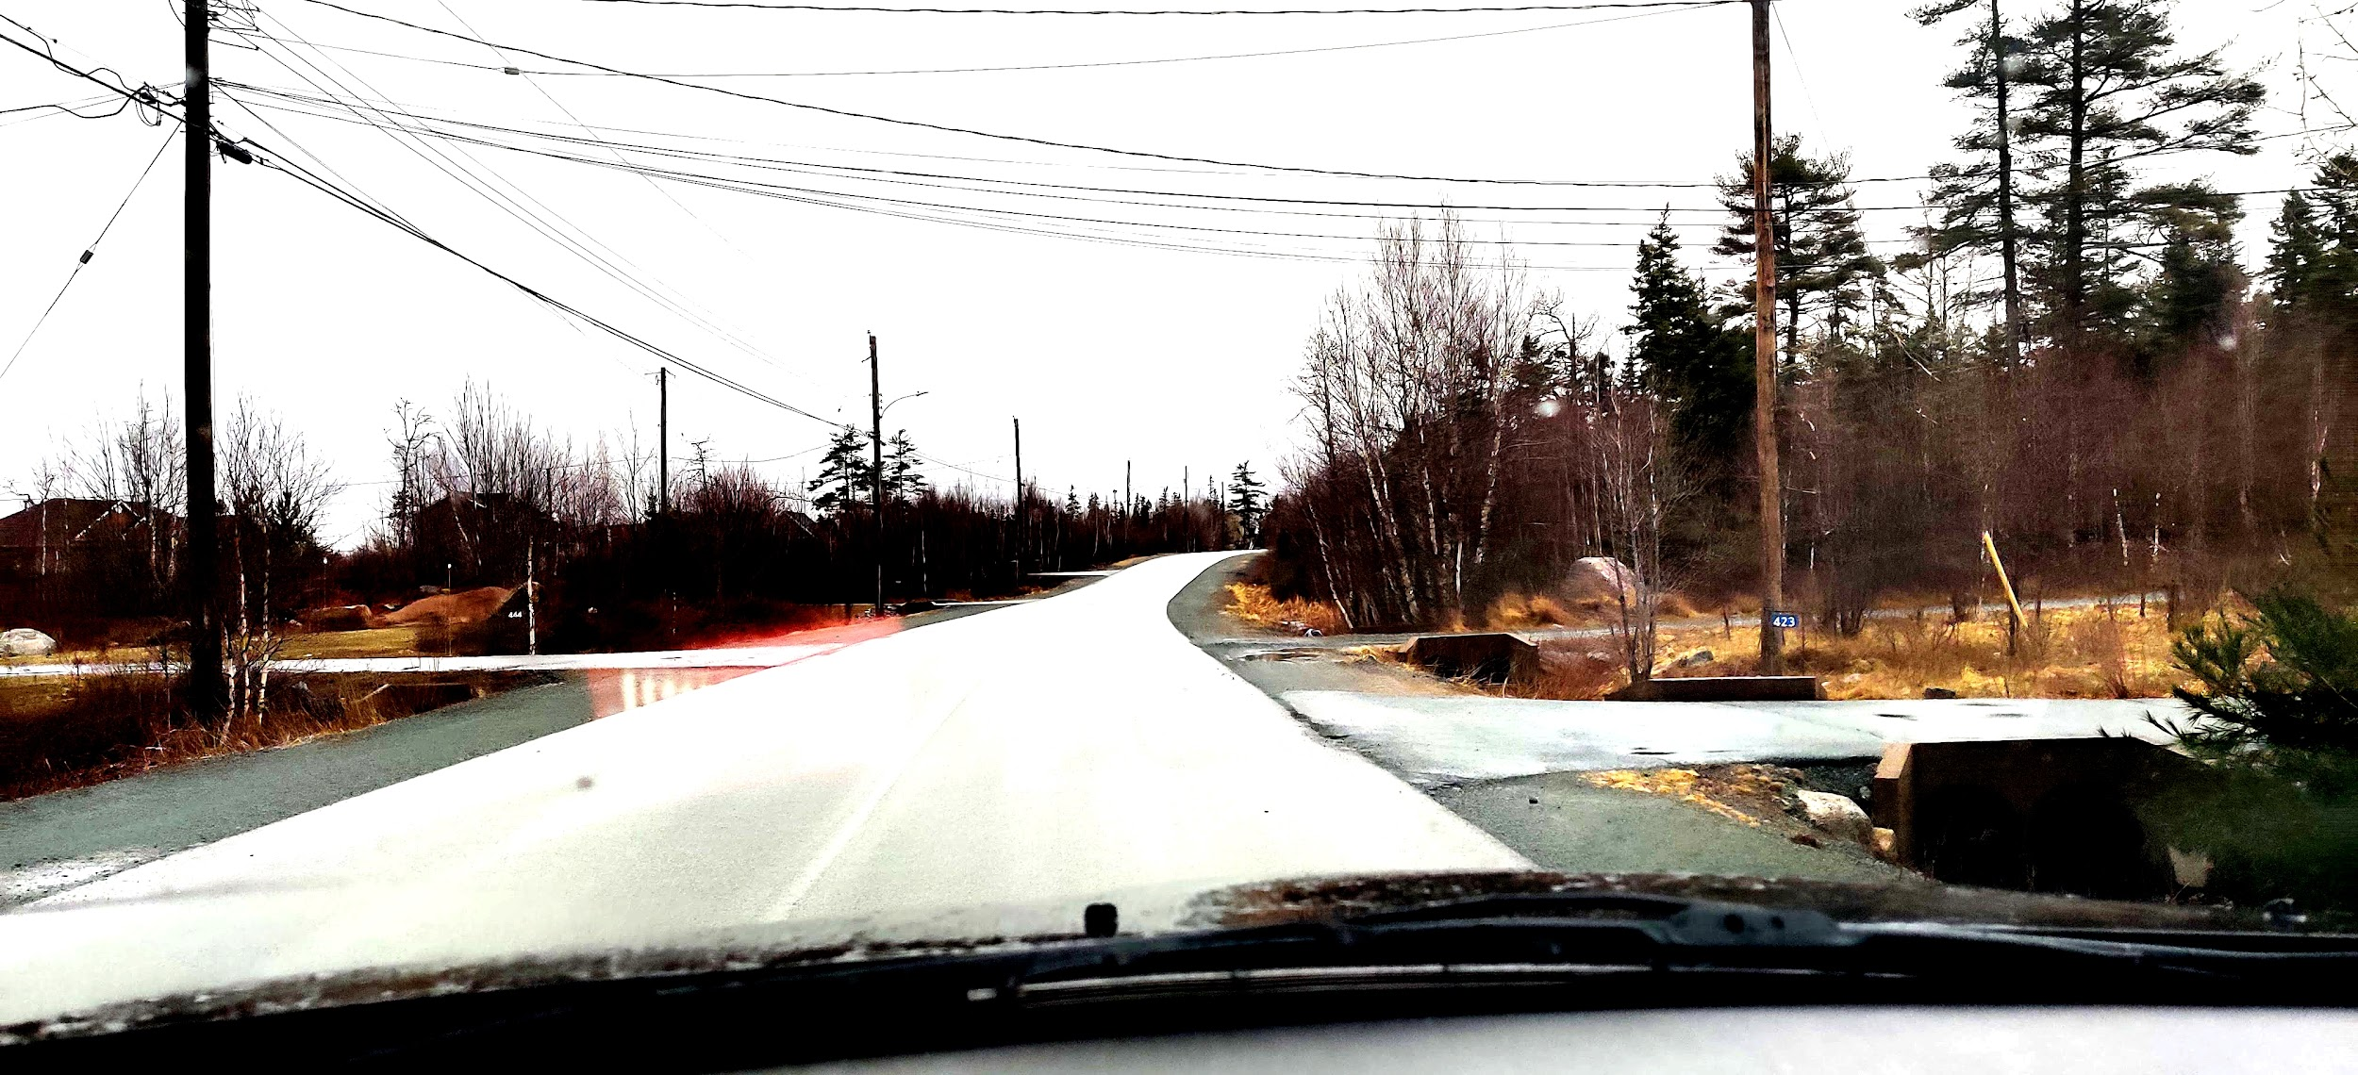
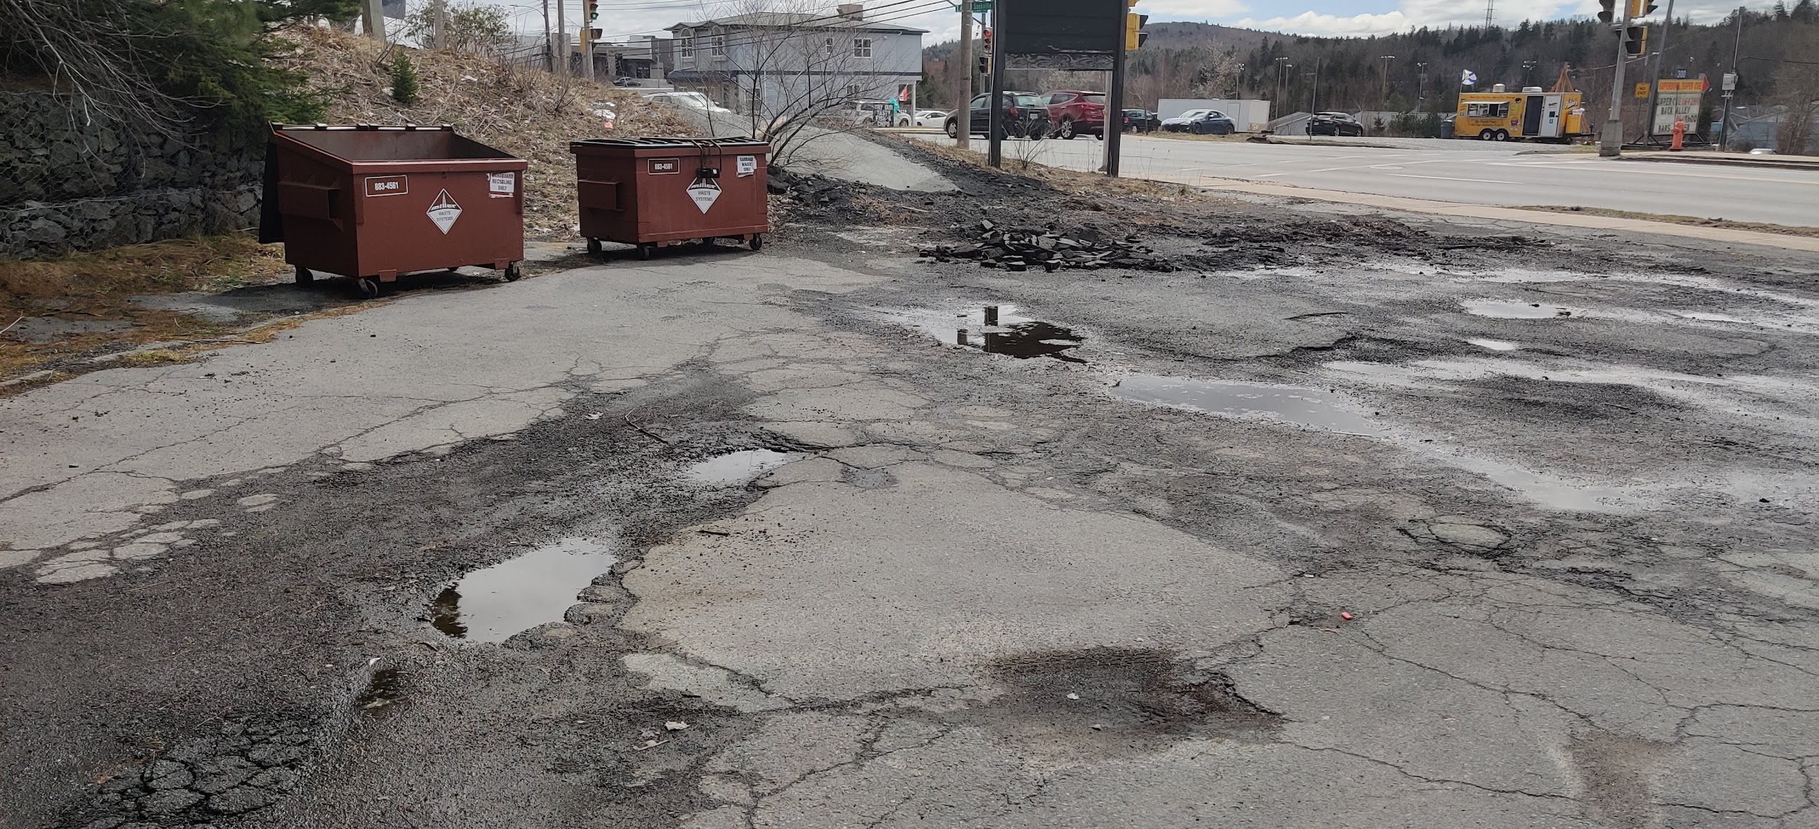
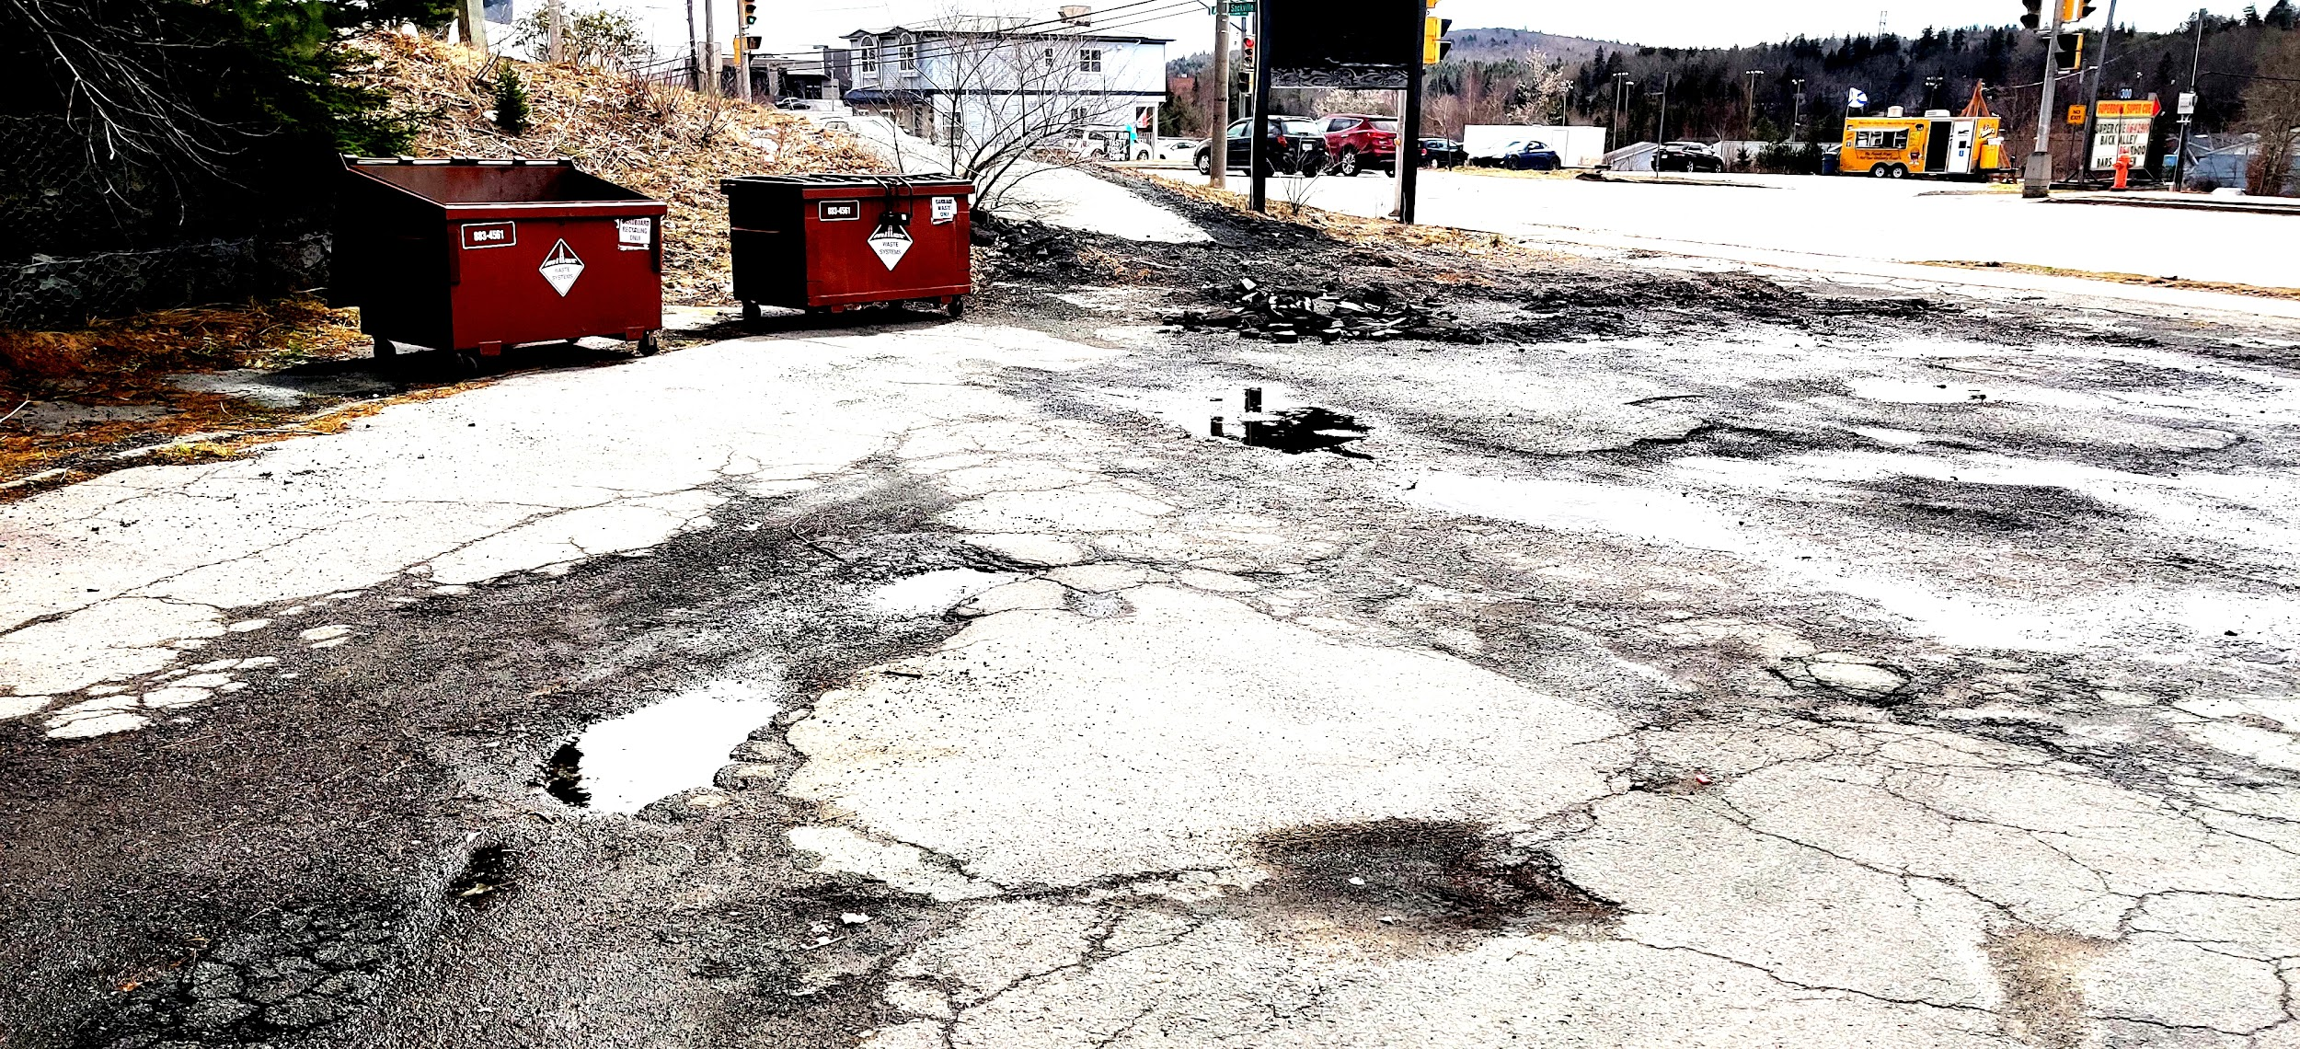
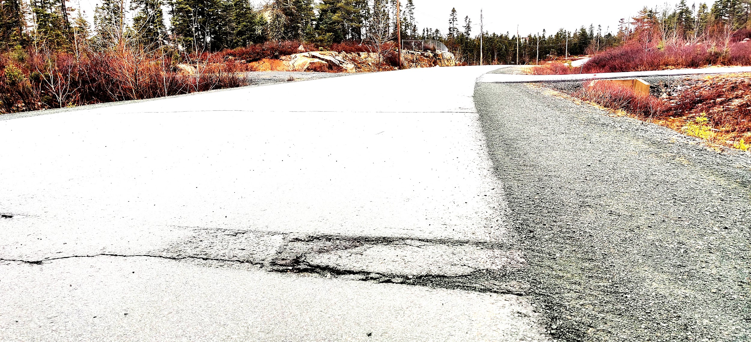
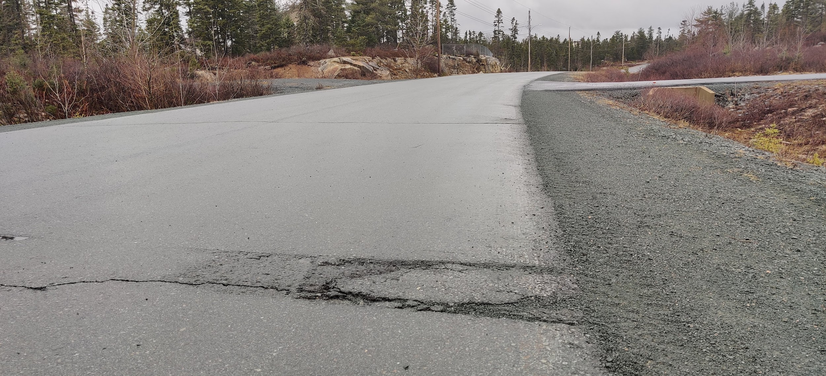
NOVA SCOTIA DATASET EXAMPLES
NORMAL
AUGMENTED

Slide 12
EXPECTED SUCCESS CRITERIA
Normal Images: 75% Accuracy
Nova Scotia Images: 70% Accuracy
Augmented Images: 80% Accuracy
Augmented Nova Scotia Images: 75% Accuracy

Slide 13
PLAN
Read in the Images for both datasets to Colab
Establish a baseline using VGG blocks
Improve upon our baseline using Machine Learning Methods
Dropout, Batch Norm, Batch Norm + Increasing Dropout
Experiment with Alternative Methods
Develop Final Model
Test Model on Test Set + Nova Scotia Images
Repeat 1-6 For Augmented Dataset

Slide 14

CONVOLUTIONAL NEURAL NETWORK

Slide 15
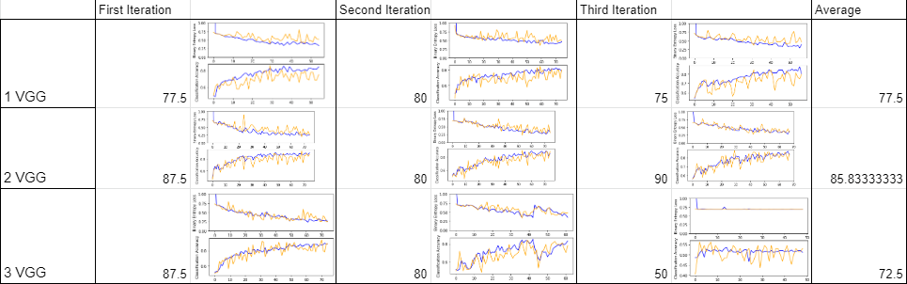
2. ESTABLISHING A BASELINE W/ VGG BLOCKS
(3 iterations on 75 Epochs, with early stopping)

Slide 16
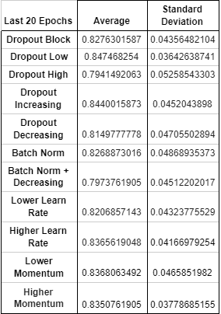
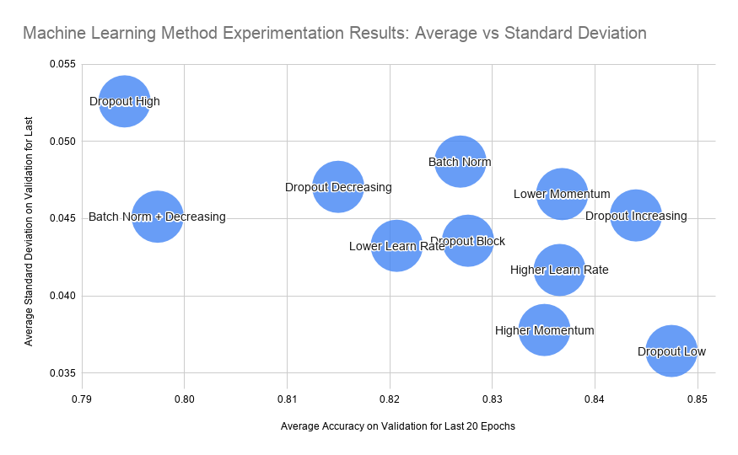
3. IMPROVE BASELINE WITH M.L. METHODS
(3 iterations on 100 Epochs, NO early stopping )
(numbers are the average of the 3 iterations average (of the last 20 epochs))

Slide 17
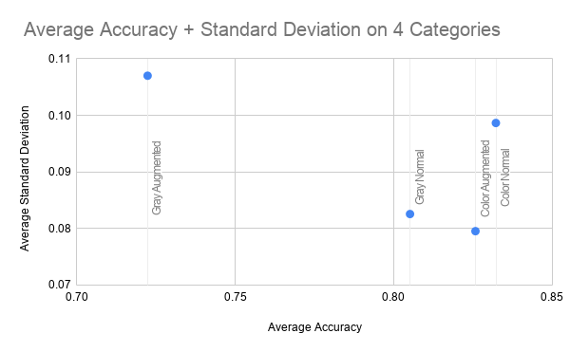
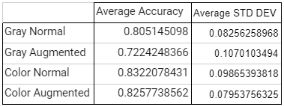
4. EXPERIMENT W/ ALTERNATIVE METHODS
Would colors affect our results? Let’s find out.
(3 iterations on 150 Epochs, late early stopping )
(numbers are the average of the 3 iterations average (of the last 50 epochs))

Slide 18
PLAN
Read in the Images for both datasets to Colab
Establish a baseline using VGG blocks
Improve upon our baseline using Machine Learning Methods
Dropout, Batch Norm, Batch Norm + Increasing Dropout
Experiment with Alternative Methods
Develop Final Model
Test Model on Test Set + Nova Scotia Images + AUGMENTED
Repeat 1-6 For Augmented Dataset

Slide 19
5. Develop our Models!
k-fold Cross Validation
Ability to save models
Keras checkpoints + callbacks
Final Model: Convolutional Neural Network w/ 2 VGG blocks + data regularization methods dropout and batch norm.
150 Epochs on 10-fold Cross Validation

Slide 20
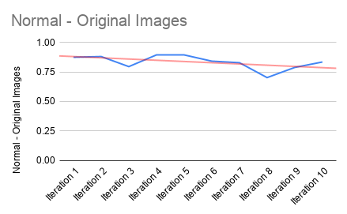
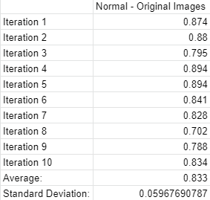
6. Results on Original Dataset
Not bad! Better than the baseline!
Fairly stable around 80%

Slide 21
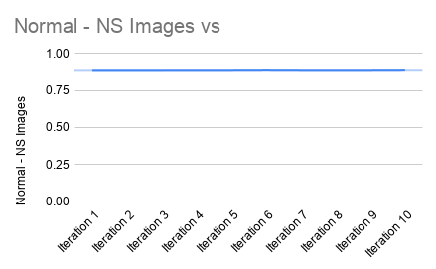
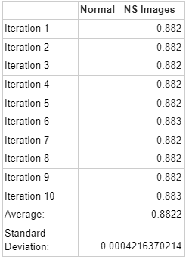
6. Normal Results on N.S. Dataset
Even better than original!
Extremely stable
(Almost unbelievably so? Due to small # of images?)

Slide 22
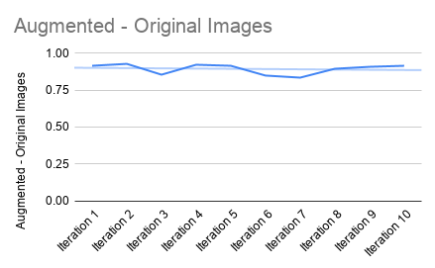
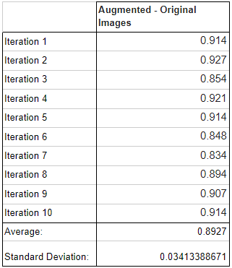
6. Augmented Results on Original Dataset
Still really good! Even better than on original
Very accurate at 90% and very stable

Slide 23
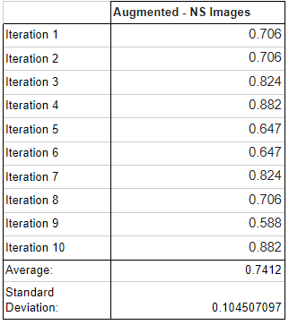
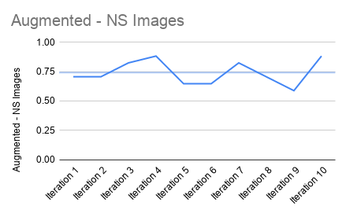
6. Augmented Results on Nova Scotia Dataset
Not so good. Unstable and random
I suspect that our model was classifying by features other than potholes
For ex. background colors

Slide 24
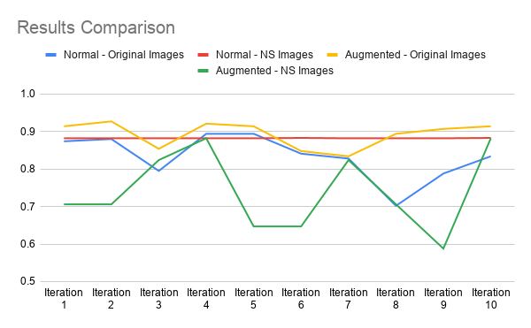
Results Evaluation

Slide 25
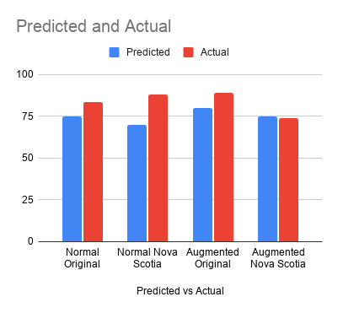
Results Conclusion
Success!
Maybe even too conservative on predictions
Augmented did not perform as well
Expected:
Majorly due to not developing its own model
Overall we were successful at developing a deep neural network that can accurately detect potholes within pictures on the internet, and from photos around N.S.

